Slide 1

BANK LOAN ANALYTICS
Excel | SQL | Tableau | Power BI

Slide 2

Group 2 - Team Members
Binal Vasant
Suparna Bar
Rohit Shinde
Pansee Patel
Ankita Rawat
Jhansi Iddamsetti
Shaileja Dasari

Slide 3
Project Overview
🏦 Banking Dataset
📊 Analytics
🛠️ Tools
💡 Outcome
Analysed loan portfolio and customer-related data.
Studied loan growth, status, payments and risk.
• Excel
• SQL
• Tableau
• Power BI
Converted raw data into meaningful business insights.
Objective: Understand loan portfolio performance, customer behaviour and credit risk.

Slide 4
Project Objectives
Portfolio Performance
Evaluate overall loan portfolio performance.
Loan Growth
Analyze yearly loan amount and loan volume.
Loan Status
Understand Current and Charged-Off loans.
Borrowing Patterns
Identify major loan purposes.
Geographic Analysis
Identify high-lending states.
Risk & Payments
Analyze verification and payment patterns.

Slide 5

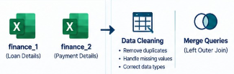
Data Modelling
Combined Finance sheet
Finance 1
Finance 2
Data Cleaning
1. Remove Duplicates
2. Handle missing Values
3. Correct Data Types
Merge Queries
(Left Outer Join)

Slide 6

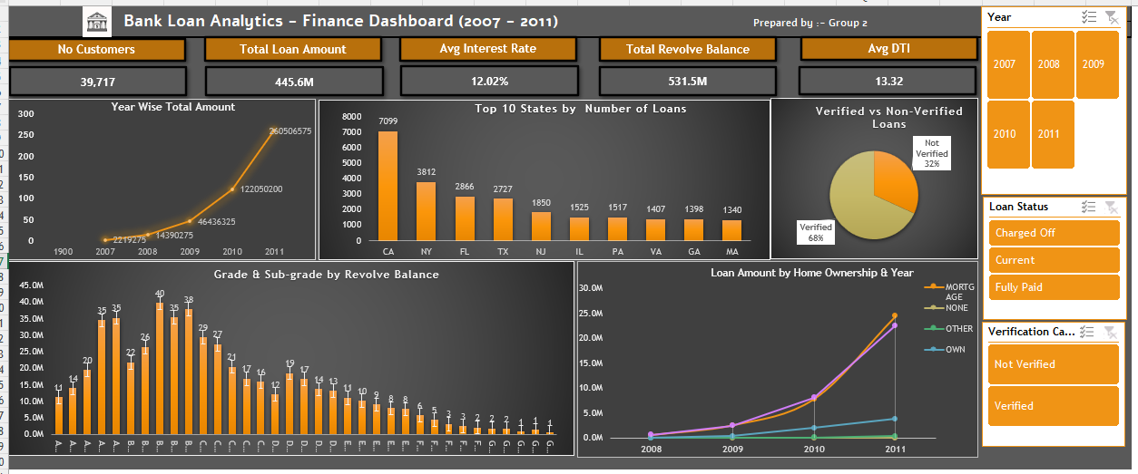
Excel Analytics
Data Import
Data Cleaning
Power Query
Merge
Analysis
Dashboard
Cleaned and transformed banking data
Handled missing values, duplicates and data types
Used Power Query and Left Outer Join
Built Pivot Tables, Pivot Charts, KPIs and slicers

Slide 7

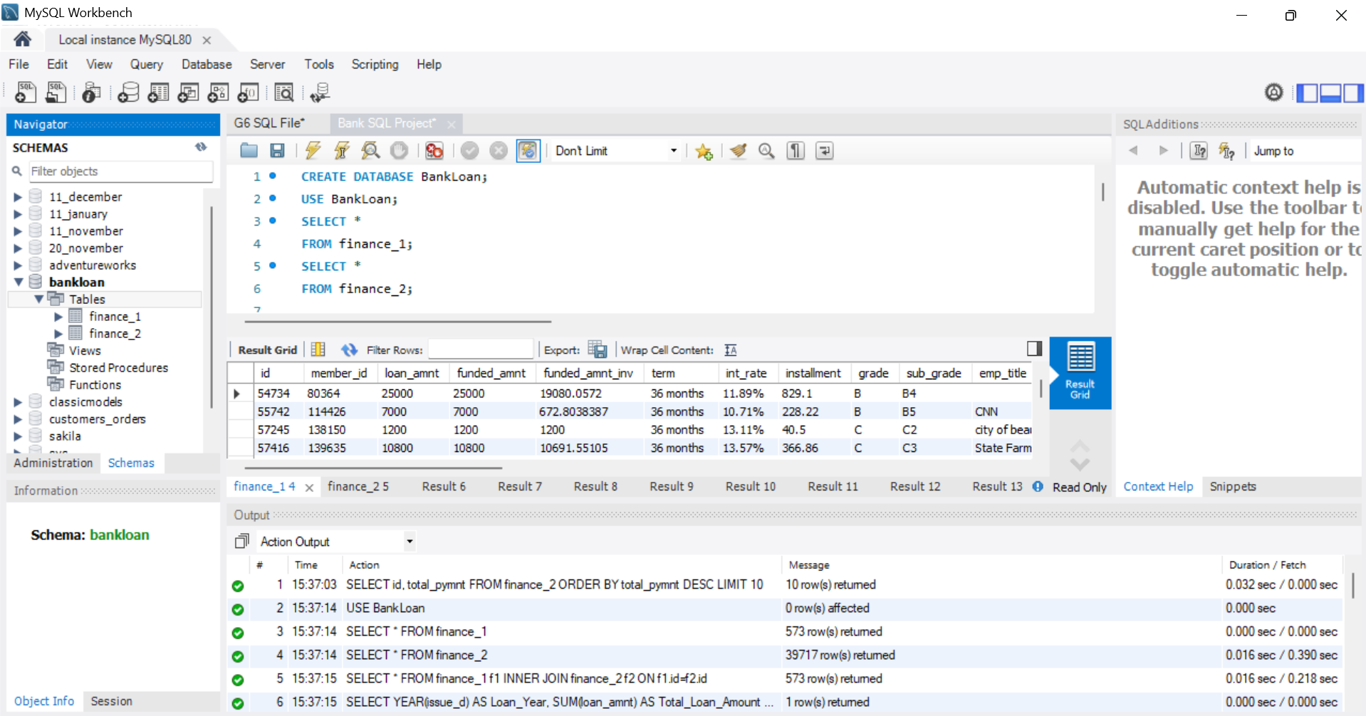
SQL Analytics
Database
Tables
Join
Queries
Aggregation
Insights
Year-wise Loan Amount
Grade & Sub-grade Revolving Balance
Verification-wise Payment
State-wise Loan Status

Slide 8

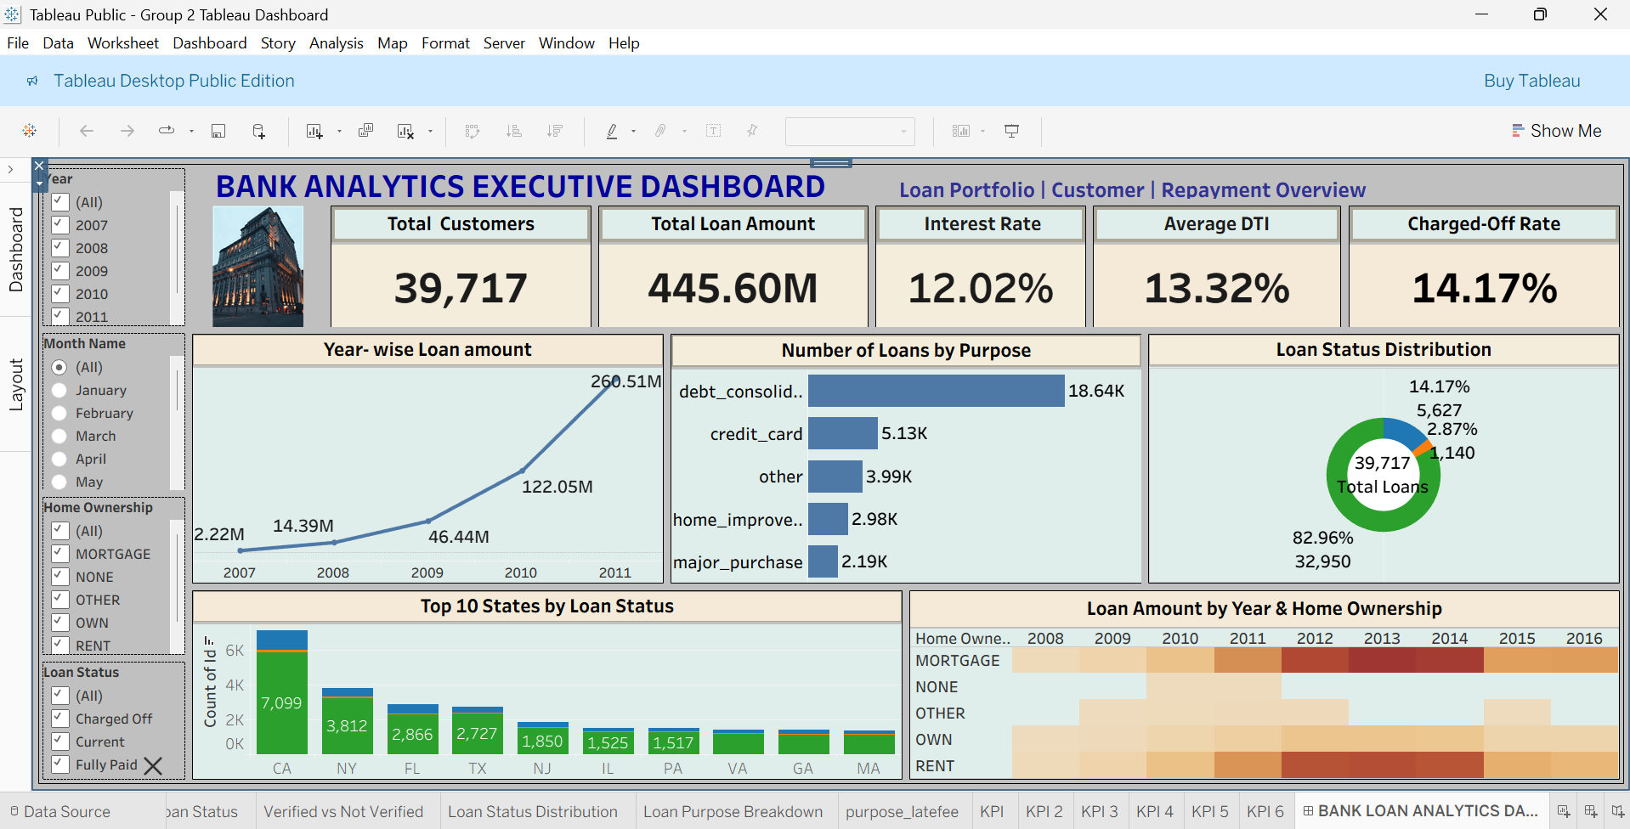
Tableau Analytics
Data Preparation
Prepared dimensions, measures and data types.
Data Integration
Used Left Join to combine relevant tables.
Visual Analytics
Created calculated fields and interactive visualizations.
Interactive Analysis
Analysed loan trends, status, states, purposes and verification.
CONNECT → PREPARE → CALCULATE → VISUALIZE → INTERACT

Slide 9

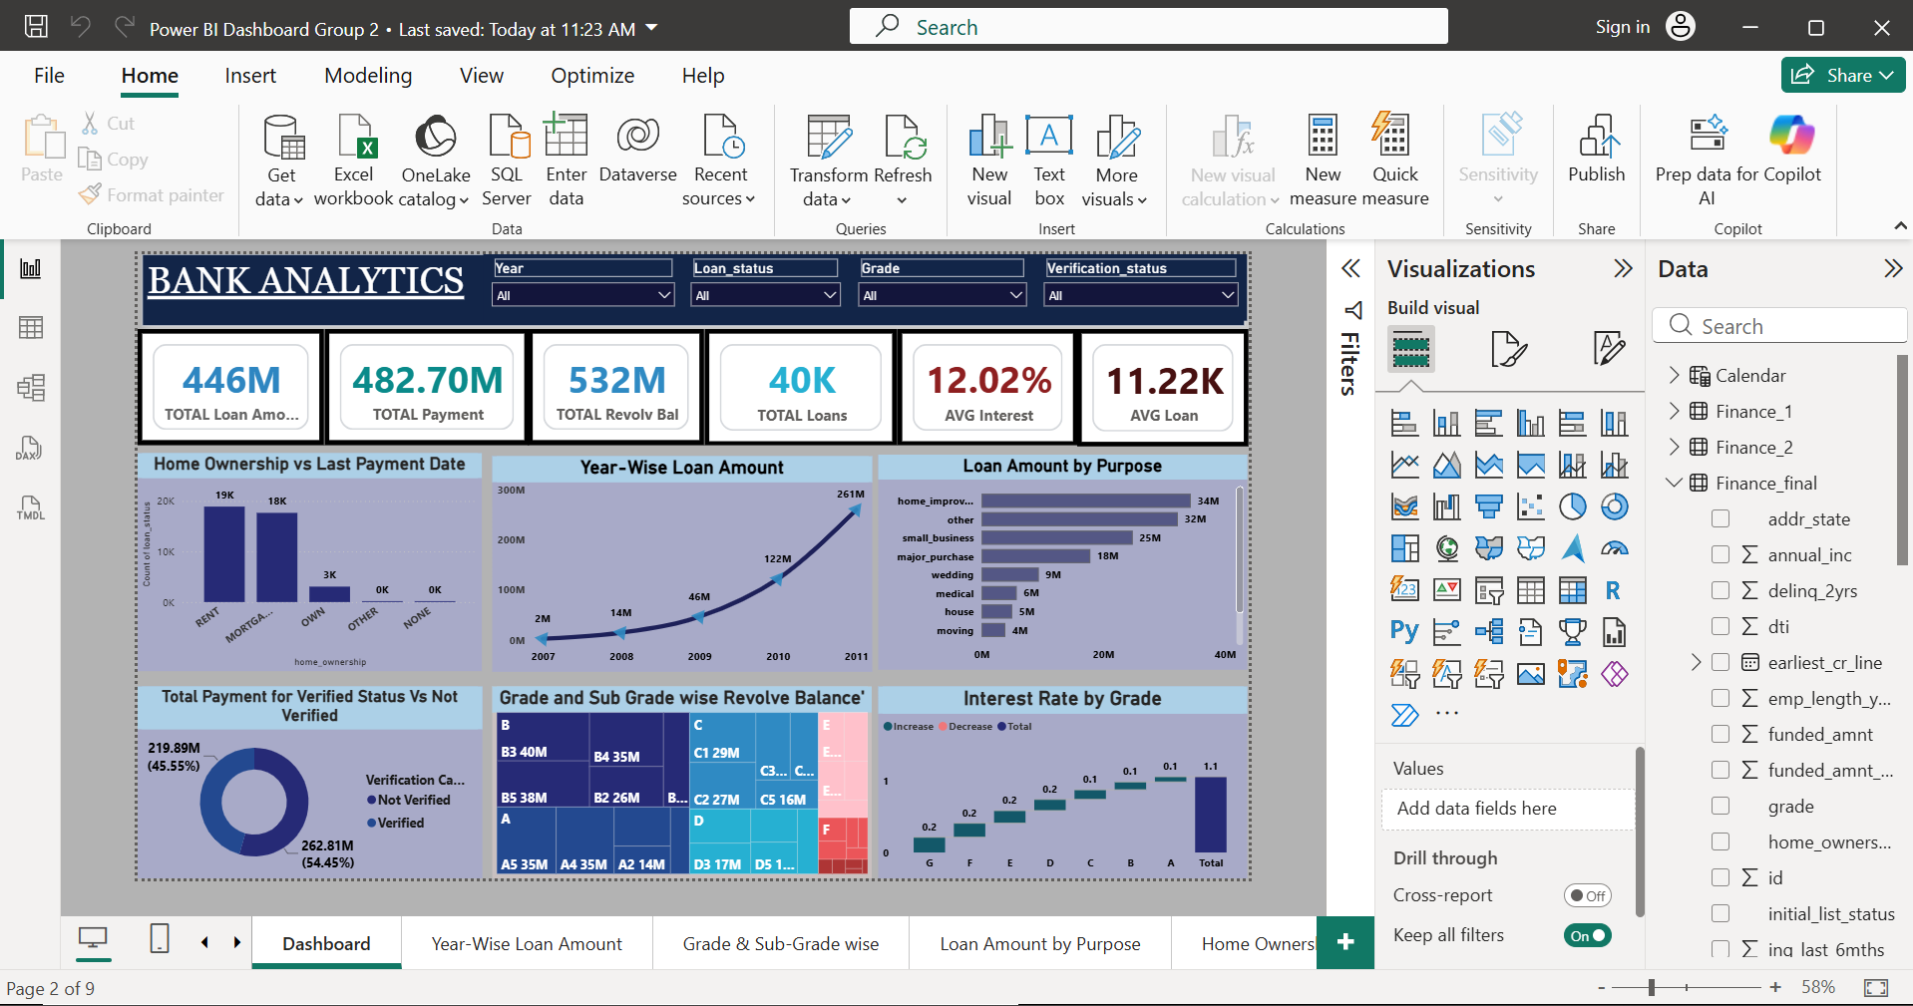
PowerBi Analytics
Banking Data
Power Query
Merge Tables
Calendar Table
Data Model
DAX Measures
Interactive Dashboard
1. KPI CARDS - Portfolio metrics
2. SLICERS - Interactive filtering
3. DAX - Calculated measures
4. RELATIONSHIPS - Connected data model

Slide 10
Common KPIs
Total Loan Amount 445.60M
Total Loans 39,717
Total Payment Received 482.70M
Average Interest Rate
12.02%
Charged-Off Rate 14.17%
Purpose: These KPIs provide a quick view of portfolio size, loan volume, payment performance, interest pricing and credit risk.

Slide 11
Key Insights & Interpretation
Loan activity increased significantly over the analyzed years, with 2011 recording the highest displayed annual loan amount (~260.51M).
California has the highest displayed loan count at approximately 7,099 loans, followed by New York and Florida.
Debt consolidation is the largest loan purpose by loan count, with approximately 18.64K loans.
Approximately 82.96% of loans are current, while 14.17% are charged off.
Verification analysis shows a significant split between verified and non-verified loans/ payments.
The charged-off segment is an important area for credit-risk monitoring.
🎯 Business Interpretation
The portfolio shows strong lending growth and a high proportion of current loans, while the charged-off segment requires further analysis to improve risk management and portfolio quality.

Slide 12
• The bank has a large and growing loan portfolio.
• Loan performance is predominantly driven by current loans.
• Debt consolidation is the major borrowing purpose.
• Lending activity is concentrated in key states such as California, New York and Florida.
• Verification status provides an additional dimension for analyzing payment and lending behavior.
• Combining KPIs and visual analysis provides a clear view of portfolio performance and risk.
Business Takeaways

Slide 13
Future Scope
Conclusion
The project demonstrates how banking data can be transformed into actionable business insights using Excel, SQL, Tableau and Power BI.
The analysis provides insights into loan portfolio growth, loan performance, borrowing patterns, geographical distribution, verification status and credit risk.
• Customer segmentation
• Credit-risk scoring
• Loan default prediction
• Early-warning indicators for potential charge-offs
• Automated dashboard refresh
• Predictive analysis of repayment behavior

Slide 14
Thank You!

